Slide 1

Name: NSHIMIYIMANA Emmanuel
Reg number: 25RP21315
PROJECT TITLE: WEATHER PREDICTION SYSTEM USING MACHINE LEARNING

Slide 2
I. PROBLEM STATEMENT
Rwanda have faced weather related disaster many times, also farmers late to plant their crops due to lack well accurate weather prediction so why I choose to predict weather using machine learning decision tree classifier model in order to predict future weather conditions(rain, sunny, drizzle or fog )
My project weather prediction system using machine learning will help to reduce those problems.

Slide 3
ii. Dataset description
Dataset is in csv excel” seattle-weather.”contains features and target.
Features(precipitation, temp_max, temp_min and wind)
Target(weather[rain,sunny,fog or drizzle])
Size of dataset: 5 colums and 1461 rows
Source:https://www.kaggle.com/datasets/ananthr1/weather-prediction.

Slide 4
iii. EDA findings
Types of EDA Applied
Univariate: first I used univariate by looking at one variable at time.
purpose: understand the distribution central tendency, and spread of each feature.
Precipitation: histogram to check how often it rains.

Slide 5
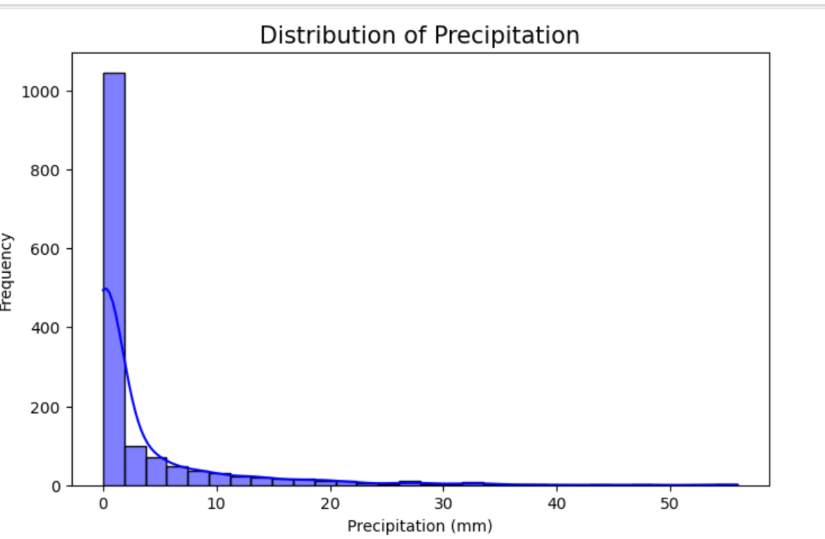
histogram of precipitation vs frequency

Slide 6
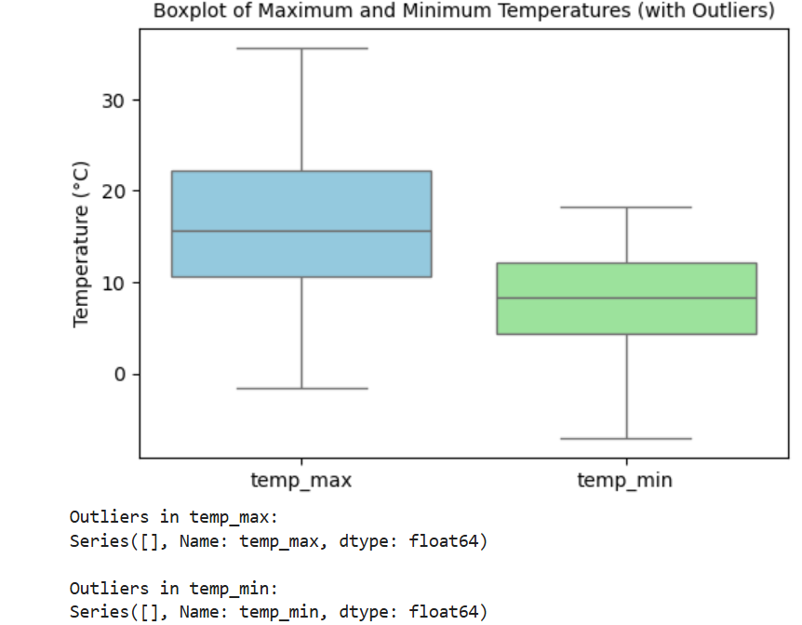
Temp_{_max} and temp_min.
Boxplots to observe average ranges(median) , average, outliers and extreme values.

Slide 7
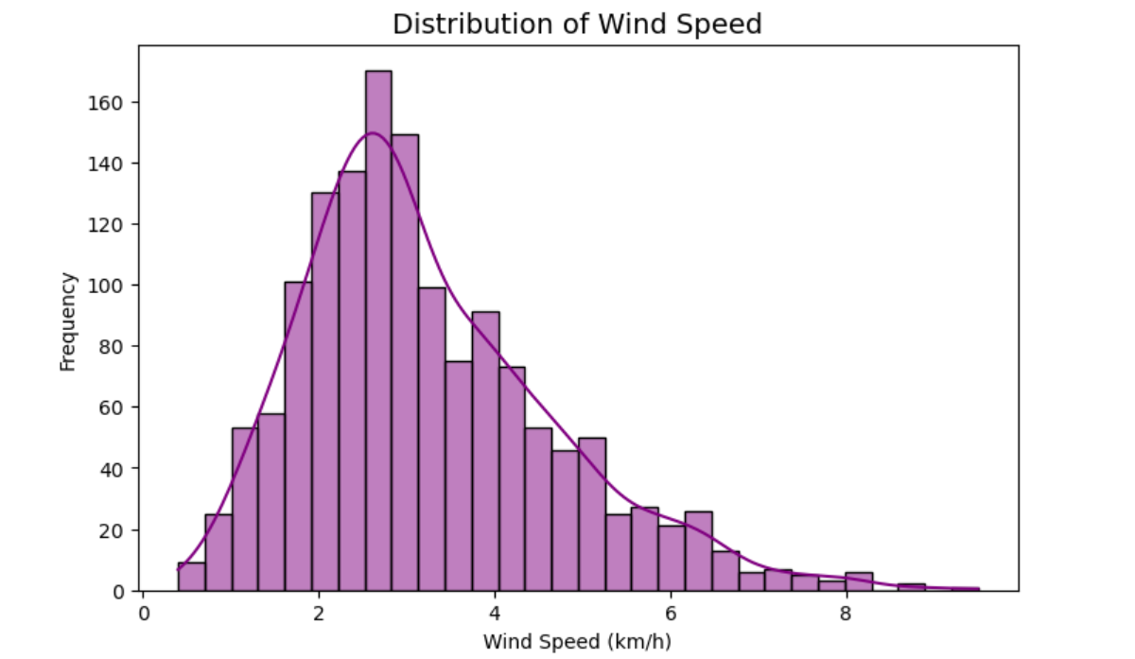
Wind
Histogram to see wind speed distribution.

Slide 8
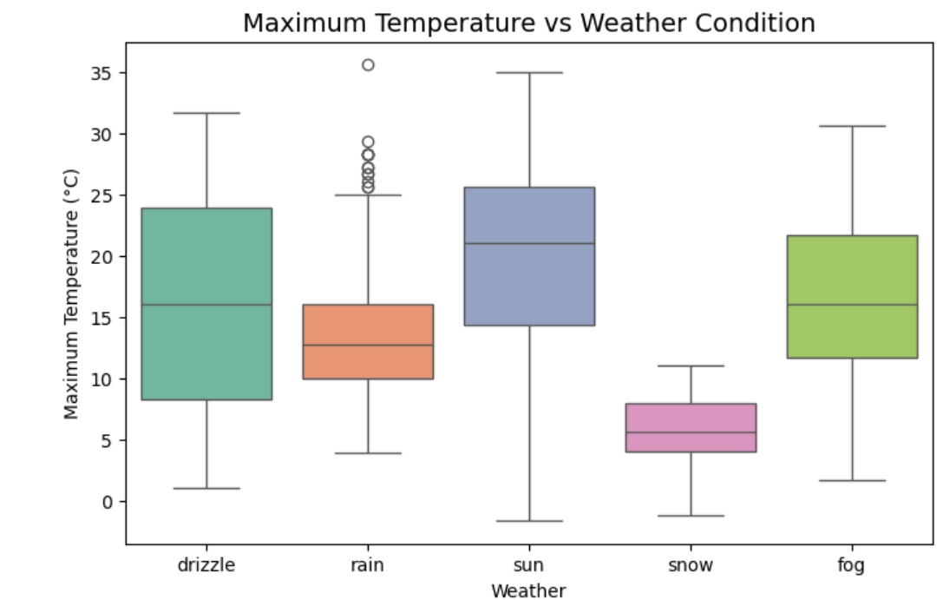
2. Bivariate Analysis
Bivariate Analysis: Compares one feature with the target variable (Weather condition) to identify which features influence weather categories (Sunny, Rainy, Drizzle, or fog)
Boxplots: 1. temp_max by weather: do rain days have lower max temp.

Slide 9
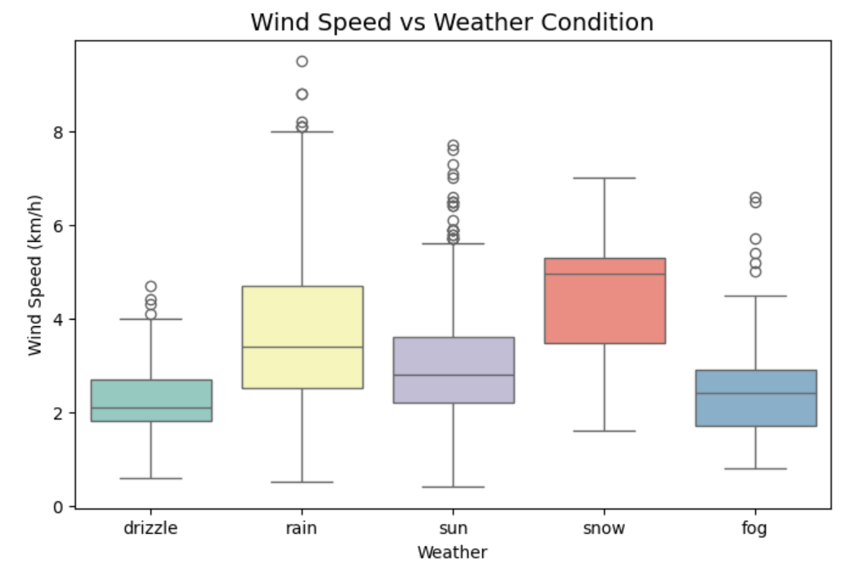
Boxchart.
Boxchart of wind by weather:

Slide 10
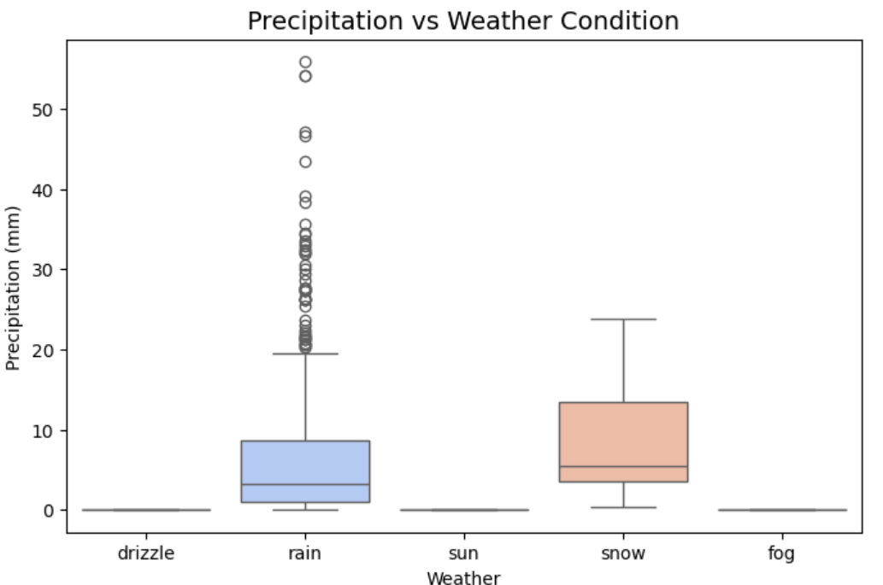
Scatterplot of precipitation vs weather

Slide 11
3.Multivariate Analysis
Studies relationships among multiple features together.
To detect correlations, collinearity, and feature interactions that affect predictions.
In this dataset:
  Correlation matrix (heatmap) → to see how temp_max and temp_min are related.
  Pairplot → to visualize joint distributions of precipitation, temp_max, temp_min, and wind, colored by Weather.

Slide 12
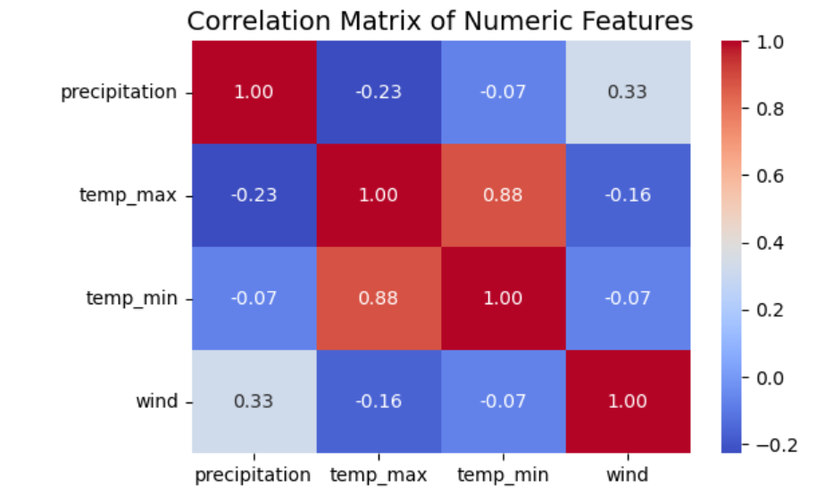
Correlation matrix

Slide 13
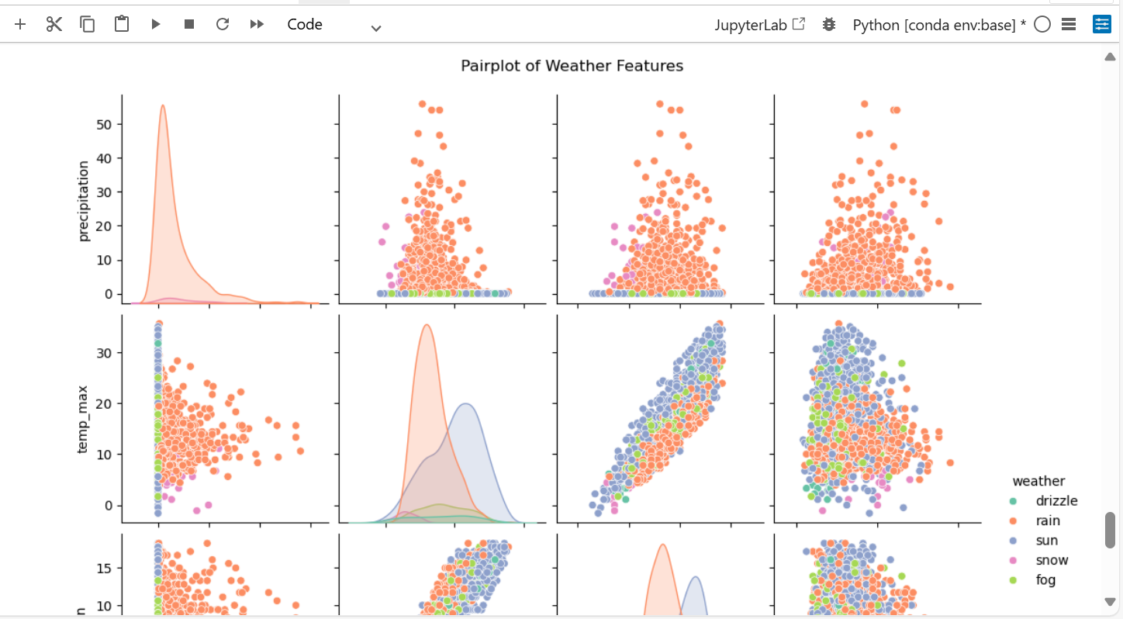
Pair plot of weather and features

Slide 14
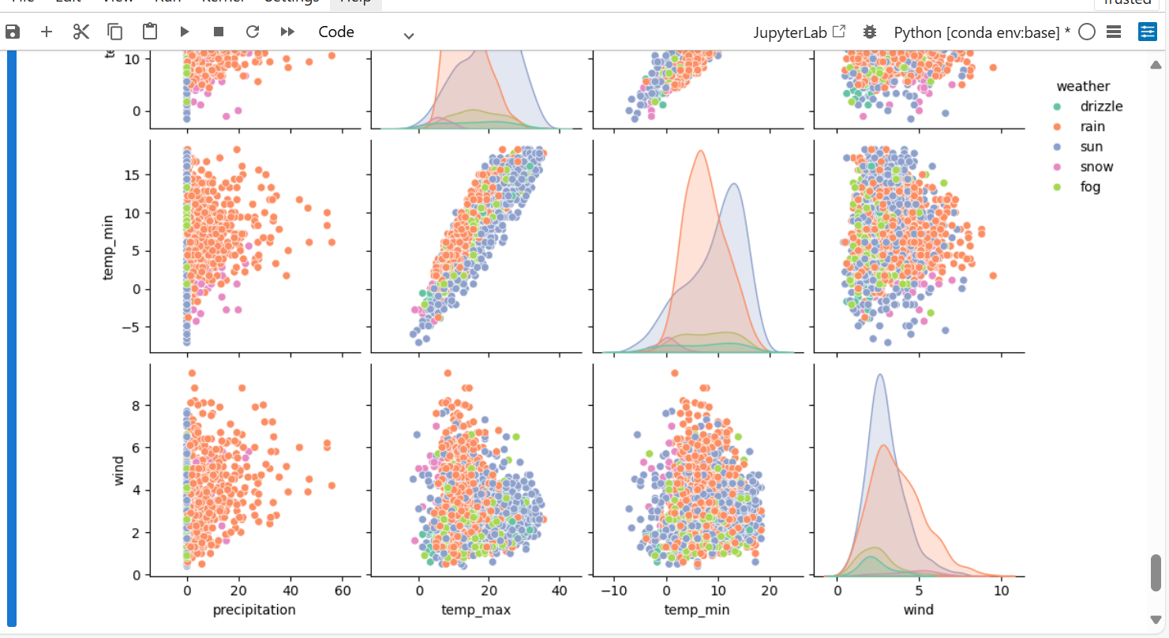
Pair plot of weather and features

Slide 15
Explore missing values, outliers, and data anomalies.
Check missing values
weather_dataset.isnull().sum(precipitation0, temp_max 0, temp_min 0, wind 0, weather 0, dtype: int64)
Check outliers: def label_outliers(series, column_name): Q1 = series.quantile(0.25) Q3 = series.quantile(0.75) IQR = Q3 - Q1 lower_bound = Q1 - 1.5*IQR upper_bound = Q3 + 1.5*IQR outliers = series[(series < lower_bound) | (series > upper_bound)]
Results:Outliers in temp_max: Series([], Name: temp_max, dtype: float64)
Outliers in temp_min: Series([], Name: temp_min, dtype: float64)
Check data anomalies: # temp_min greater than temp_max
anomalies = weather_dataset[weather_dataset['temp_min'] > weather_dataset['temp_max']]
print(anomalies)
# negative precipitation
anomalies_precip = weather_dataset[weather_dataset['precipitation'] < 0]
print(anomalies_precip)

Slide 16
iv. Feature engineering steps applied and justification.
Check missing values and handle missing values: no missing values in dataset
# Check how many missing values in each column
print(weather_dataset.isnull().sum())
Handle outliers and anomalies: in my dataset there is no outliers and anomals
Code:

Slide 17
Code to check outliers
# Function to detect outliers using IQR
def detect_outliers_iqr(data, column):
Q1 = data[column].quantile(0.25)
Q3 = data[column].quantile(0.75)
IQR = Q3 - Q1
lower = Q1 - 1.5 * IQR
upper = Q3 + 1.5 * IQR
outliers = data[(data[column] < lower) | (data[column] > upper)]
return outliers, lower, upper
# Example: detect outliers in temp_max
outliers_temp_max, lower, upper = detect_outliers_iqr(weather_dataset, 'temp_max')
print("Outliers in temp_max:", outliers_temp_max.shape[0])
print("Lower bound:", lower, "Upper bound:", upper)

Slide 18
Perform Data Transformation
This help to prepare dataset for machine learning by converting categorical values into numbers and scaling numerical features.
In the target column weather (Rain, Sun, Drizzle and fog) is categorical data so we need “Encode the label”
We need to convert weather column to numbers:Classes (encoded): {0: 'drizzle', 1: 'fog', 2: 'rain', 3: 'snow', 4: 'sun'}
scaling numerical features: I have used Decision Trees algorithm which don’t need normalization or standardization.
Reason: A Decision Tree splits data by comparing values with thresholds (e.g., temp_max > 25°C).

Slide 19
Apply feature extraction if relevant
Feature extraction:PCA not needed (dataset is small).
Text extraction not needed (no text).
v. Model building and evaluation process
Model: I used DecisionTreeClassifier model
Train and test model: # 5) Train Decision Tree# -------------------------weather_dataset_model = DecisionTreeClassifier(random_state=42)weather_dataset_model.fit(X_train, y_train)
Occuracy of the model is 74.7440

Slide 20
vi. Model deployment details
I deployed my model by using streamlit framework.
Model deployed on streamlit cloud by using GitHub, my weather prediction app now you can access it online use of smartphone or computer using this link: https://weather-prediction-app-krbrb9zblf72dpyr9gw3bh.streamlit.app/
You can predict by input single data or upload excel file and predict all at once.
The app has place to input data and predict weather button you click on to show the results.
The following slides there is picture to show deployed model.

Slide 21
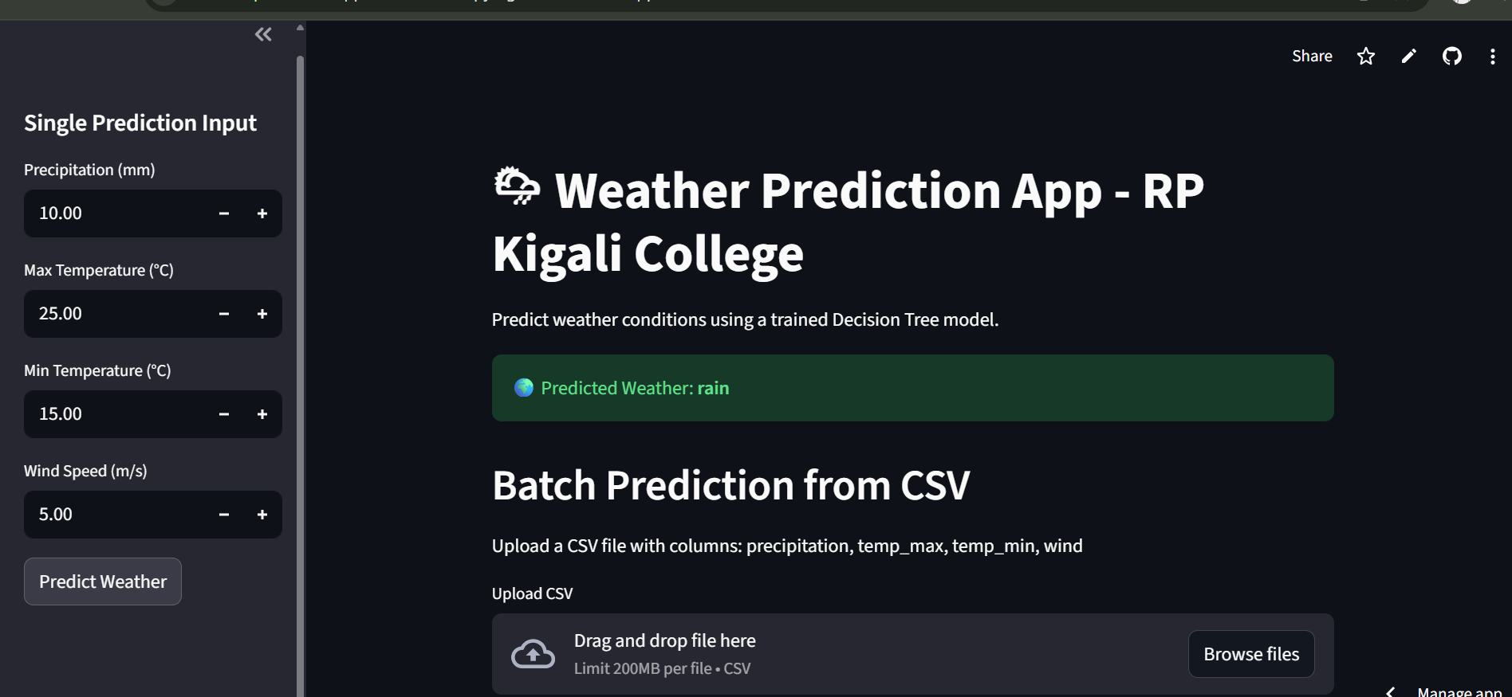
Model deployed screen shoot this the deployed app to predict weather, so here is for single input data.

Slide 22
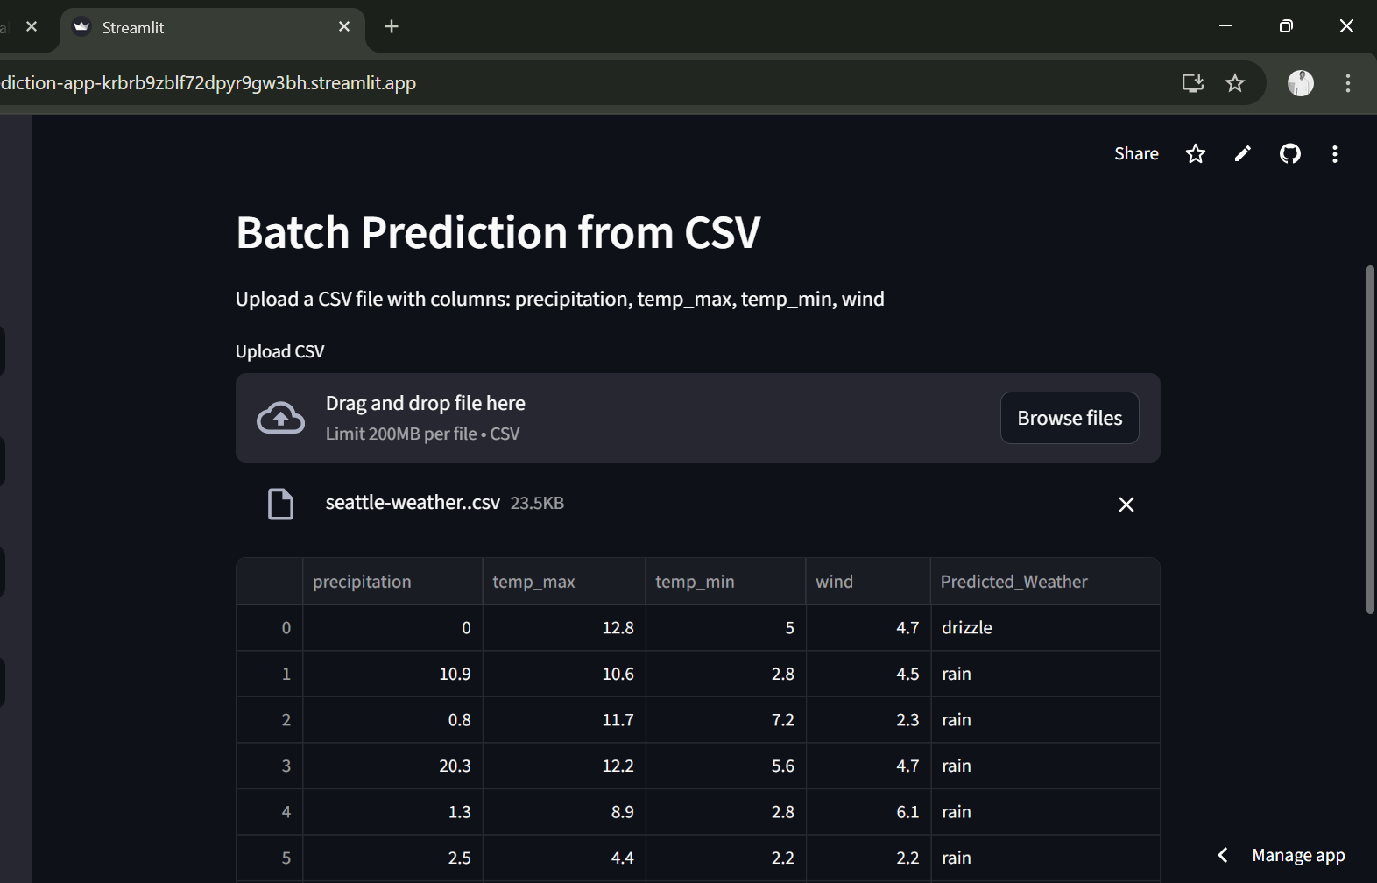
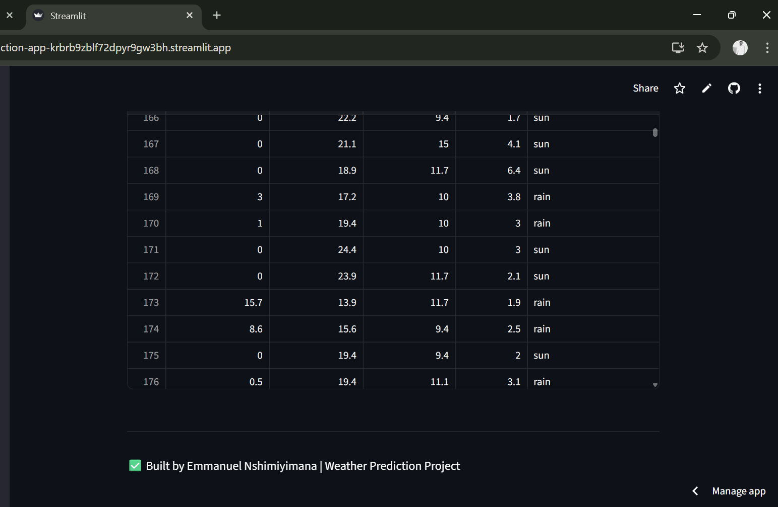
You can predict by upload csv file

Slide 23
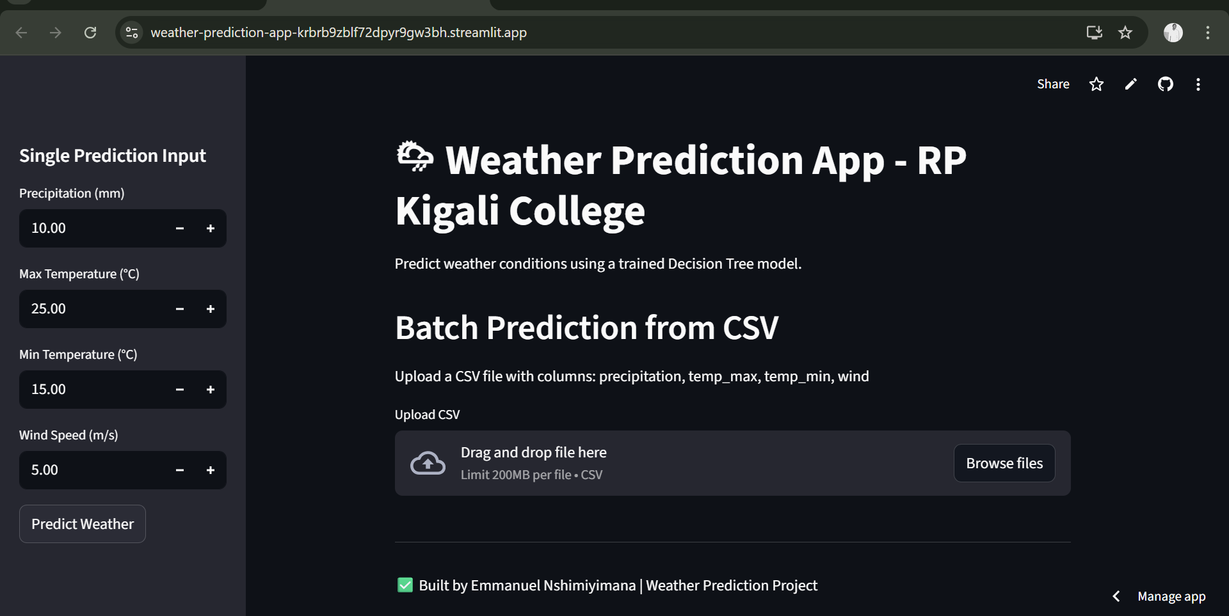
Thanks!!!

